Slide 1
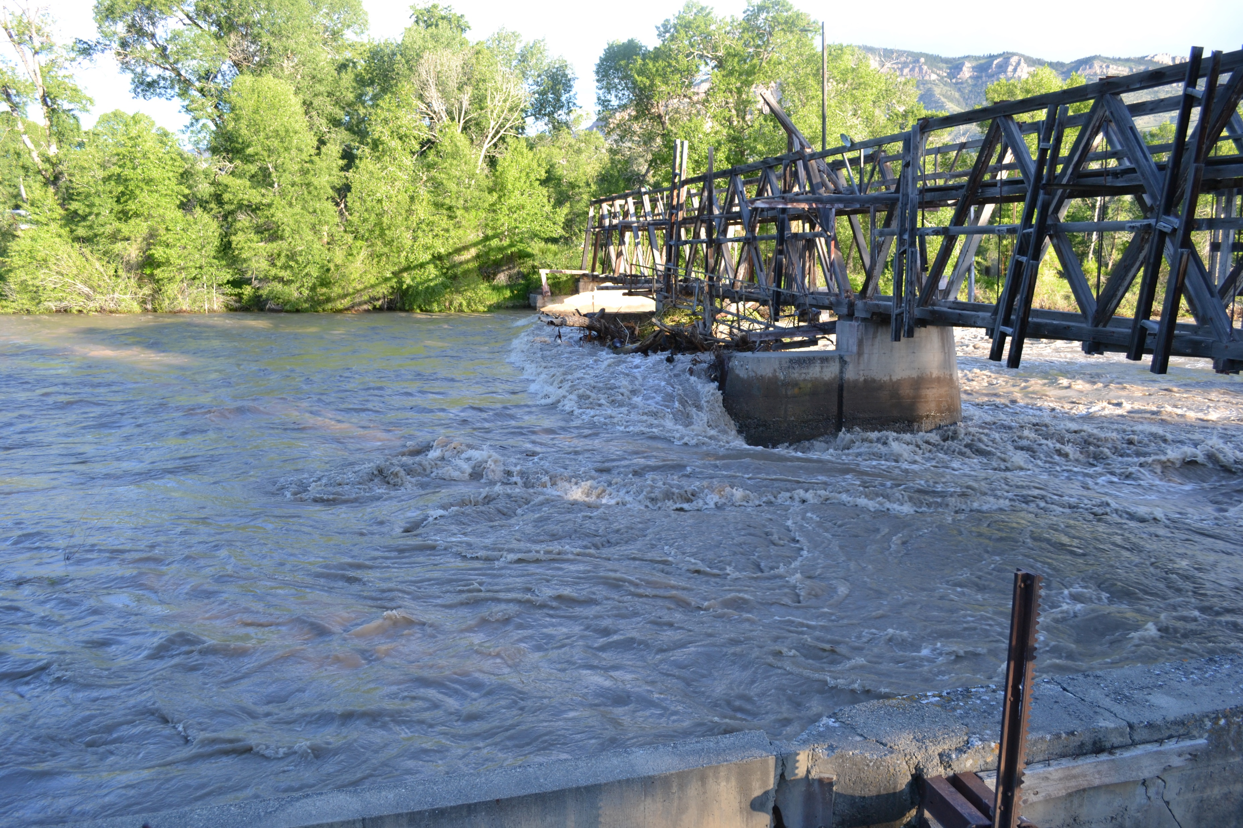
Small Acreage Workshop
Presented By Jerry Bales
History of Cody Canal
Water Rights
Irrigation methods

Slide 2
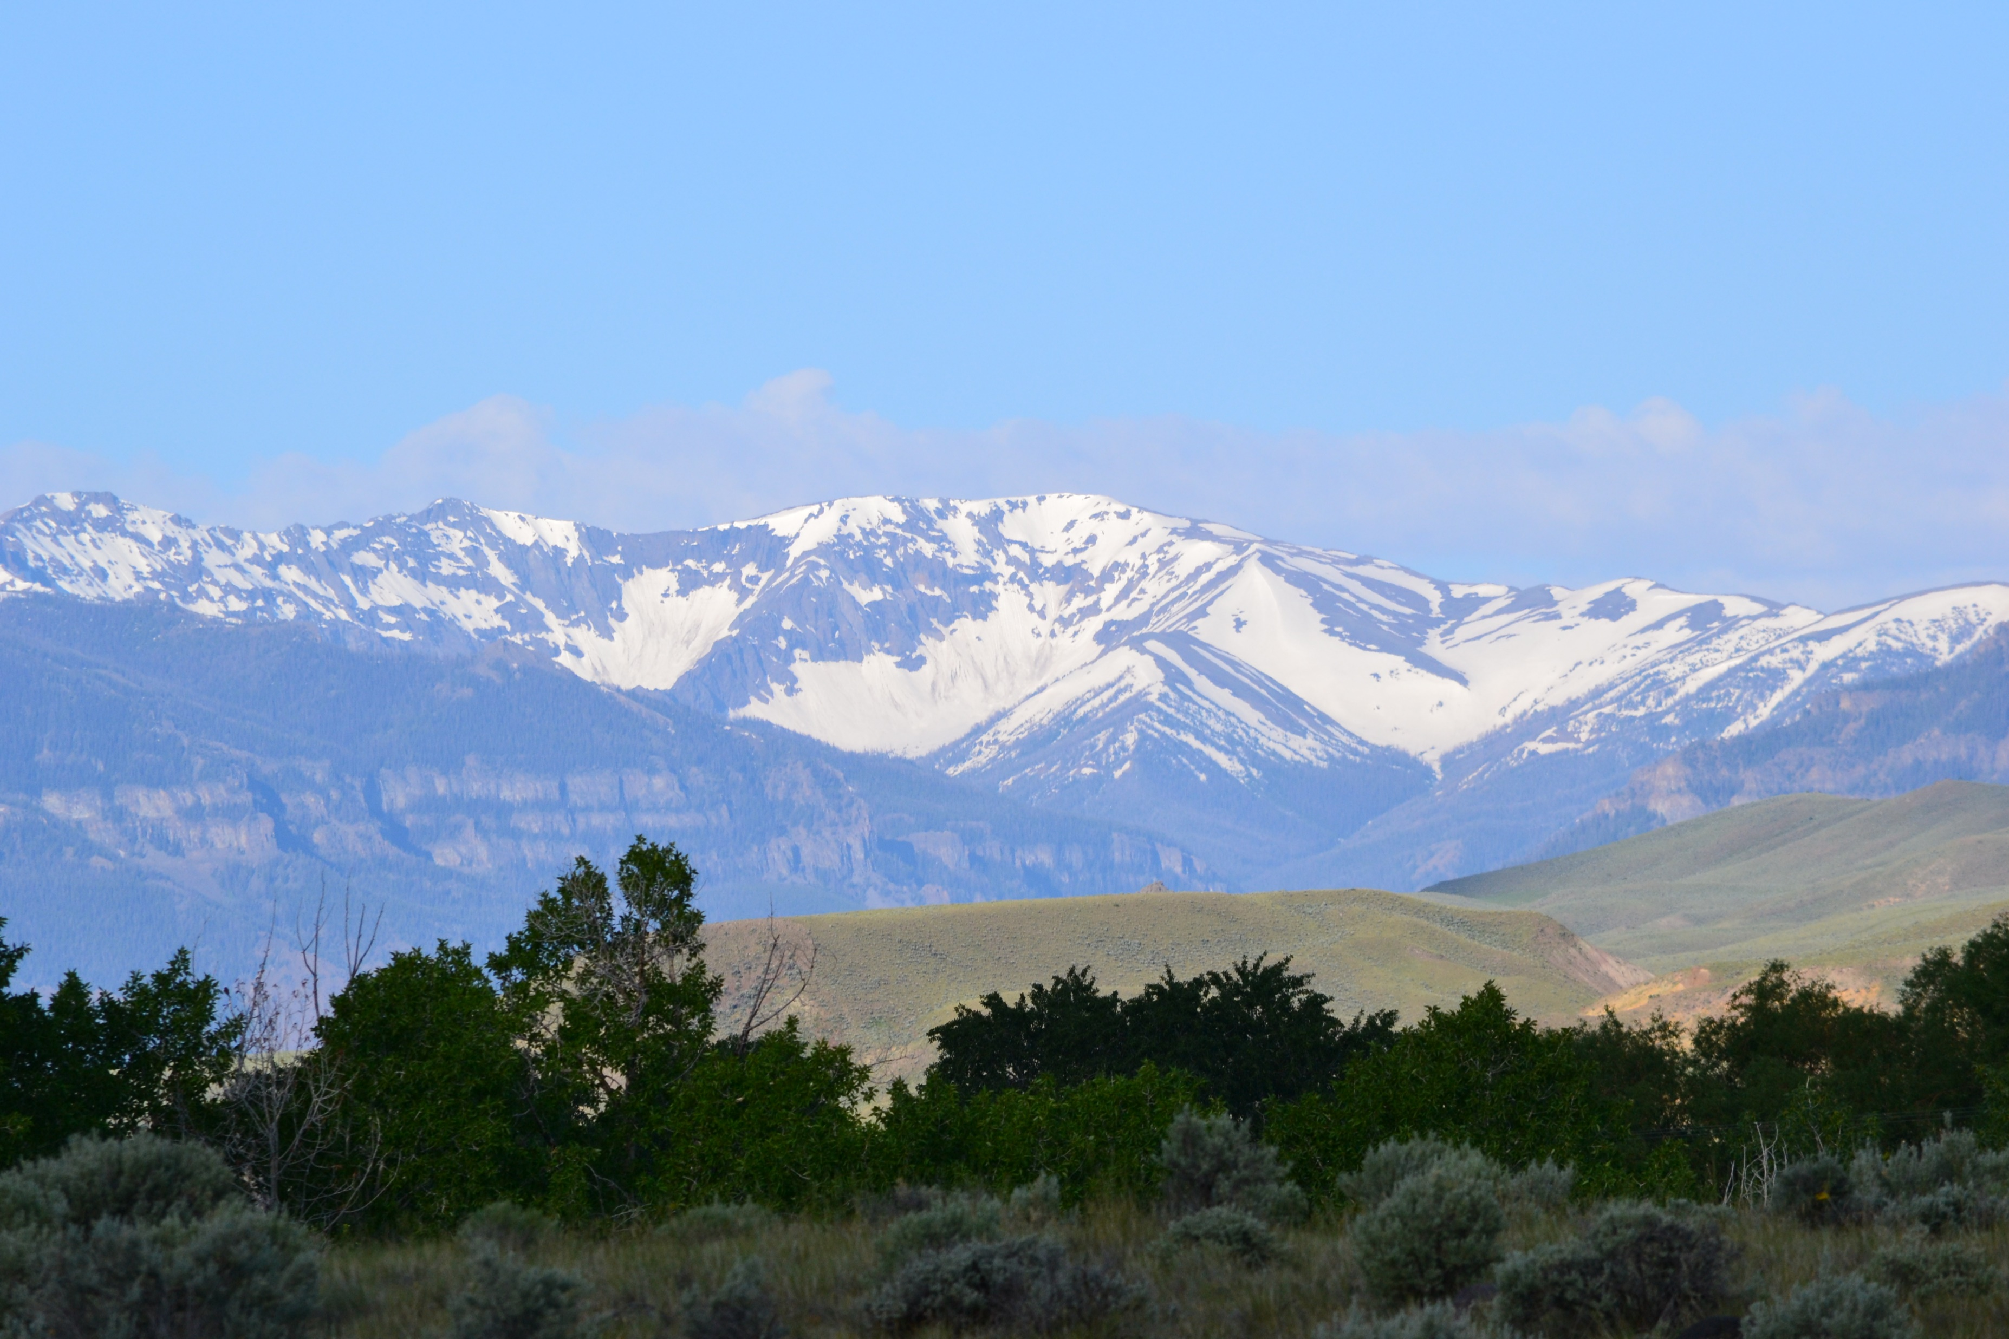
Main Topics
Carey Act
Water Rights in Wyoming
History Of Cody Canal
Irrigation Types

Slide 3
Carey Act
Congress passed the Carey Act in 1894
The Federal government were given to the States, land to develop Irrigation districts
Then the States gave the lands to the Irrigation Company's, to build the irrigation systems, and settle the lands.
The sale of the lands, along with investors was to pay for the construction of the canals.
Many companies went broke trying to make it happen.

Slide 4
Water Rights
Who controls, and oversees water in Wyoming?
What is a Water Right?
Do I have a Water Right?
How much water am I able to use?

Slide 5
Water Rights
State of Wyoming controls all waters in Wyoming.
State Engineer Office, and State Board of control oversee all use of waters and maintain the records.
Water is allocated through a permit process. This is for both Surface, and Ground water.
Water is allocated on a prior of appropriation. First claim of rights on the waterway has the most senior rights to use the water.
Beneficial use may be agriculture, municipal, domestic, stock and industrial to mane a few.

Slide 6
What is a water right?
A water right is the right to use water after a permit is granted by the state.
The permitting process is:
  Submit an application to the state engineer office.
  The state will review the application and grant a permit to begin construction to show beneficial use of the water.
  The state will inspect the use of the water to confirm beneficial use.
  The state will issue a certificate of appropriation. Then you have an adjudicated water right. That will be tied to the land even if ownership changes.

Slide 7
Do I have water rights?
Determining whether or not water rights are associated with your property is important. You should not assume you have rights to an irrigation ditch or the associated water even if it crosses your land, as that water could be allocated to someone else’s property.
Contact the State Engineer’s Office or your local water commissioner, use the State Engineer’s Office e-Permit online database, or visit the county clerk’s office of where your property resides to determine if water rights are associated with the property.
The public land survey system legal description of a property is defined as the quarter-quarter (or possibly tract or lot), section, township, and range referenced to a principal meridian and base line. The public land survey system legal description of your property may or may not be printed on your property tax assessment notice or tax bill.
A county assessor’s office should be able to tell you whether or not an irrigation district administers your water rights and, if so, the name of the district. Many irrigation districts assess fees for operation, maintenance, and rehabilitation expenses from landowners whose properties have water rights associated with them. The county assessor’s office collects this annual fee.
If an irrigation district doesn’t exist, and you have water rights, a less formal “entity” may have formed to deliver water. Examples include ditch companies, corporations, and homeowner associations. You may not be in any kind of organized district, ditch company, or association at all. Your water right may simply be a single diversion out of a creek or stream or a ditch shared with several common landowners.

Slide 9
How much water am I able to use?
The certificate of appropriation will have amount of water allowed. If you own a part of the certificate, it be as followed.
In Wyoming, a basic water right for irrigation from a surface water source is 1 cubic foot per second (CFS) for 70 acres of land. One CFS is equal to approximately 450 gal/ min. Which breaks down to 6.4 Gals/Min/Acre.
One CFS delivered continuously for 1 day is equivalent to 1.98 acre-feet of water. An acre-foot is the volume of water to cover an acre of land 1-foot deep, about enough water to provide two households with water for one year.

Slide 10
Cody Canal Irrigation District
George Beck, William Cody along with other investors formed the Shoshone Irrigation Company in early 1890’s.
The State approved the application for Shoshone Irrigation Company in 1895.
They took over lands form several small ditch systems that had already been using waters under territorial permit.
  Bailey and Marion ditches are the two I am aware of. Also, there may have been more that were near the Town of Marquette.

Slide 11
Cody Canal Application

Slide 12
Shoshone Irrigation Company
1900
Large farms is how the system was originally designed. Farmers worked with their neighbors by rotating water, helping with crop planting, and harvest. The farm was the main source of income. Flood irrigating was the normal, taking advantage of gravity. This means you need a larger amount of water to push the water across the field. As the water flows across the field, you lose water to evaporation and soaking into the soil. Rotation of the water with neighbors was the way to get a large enough head of water to cover the field in a reasonable time.

Slide 13
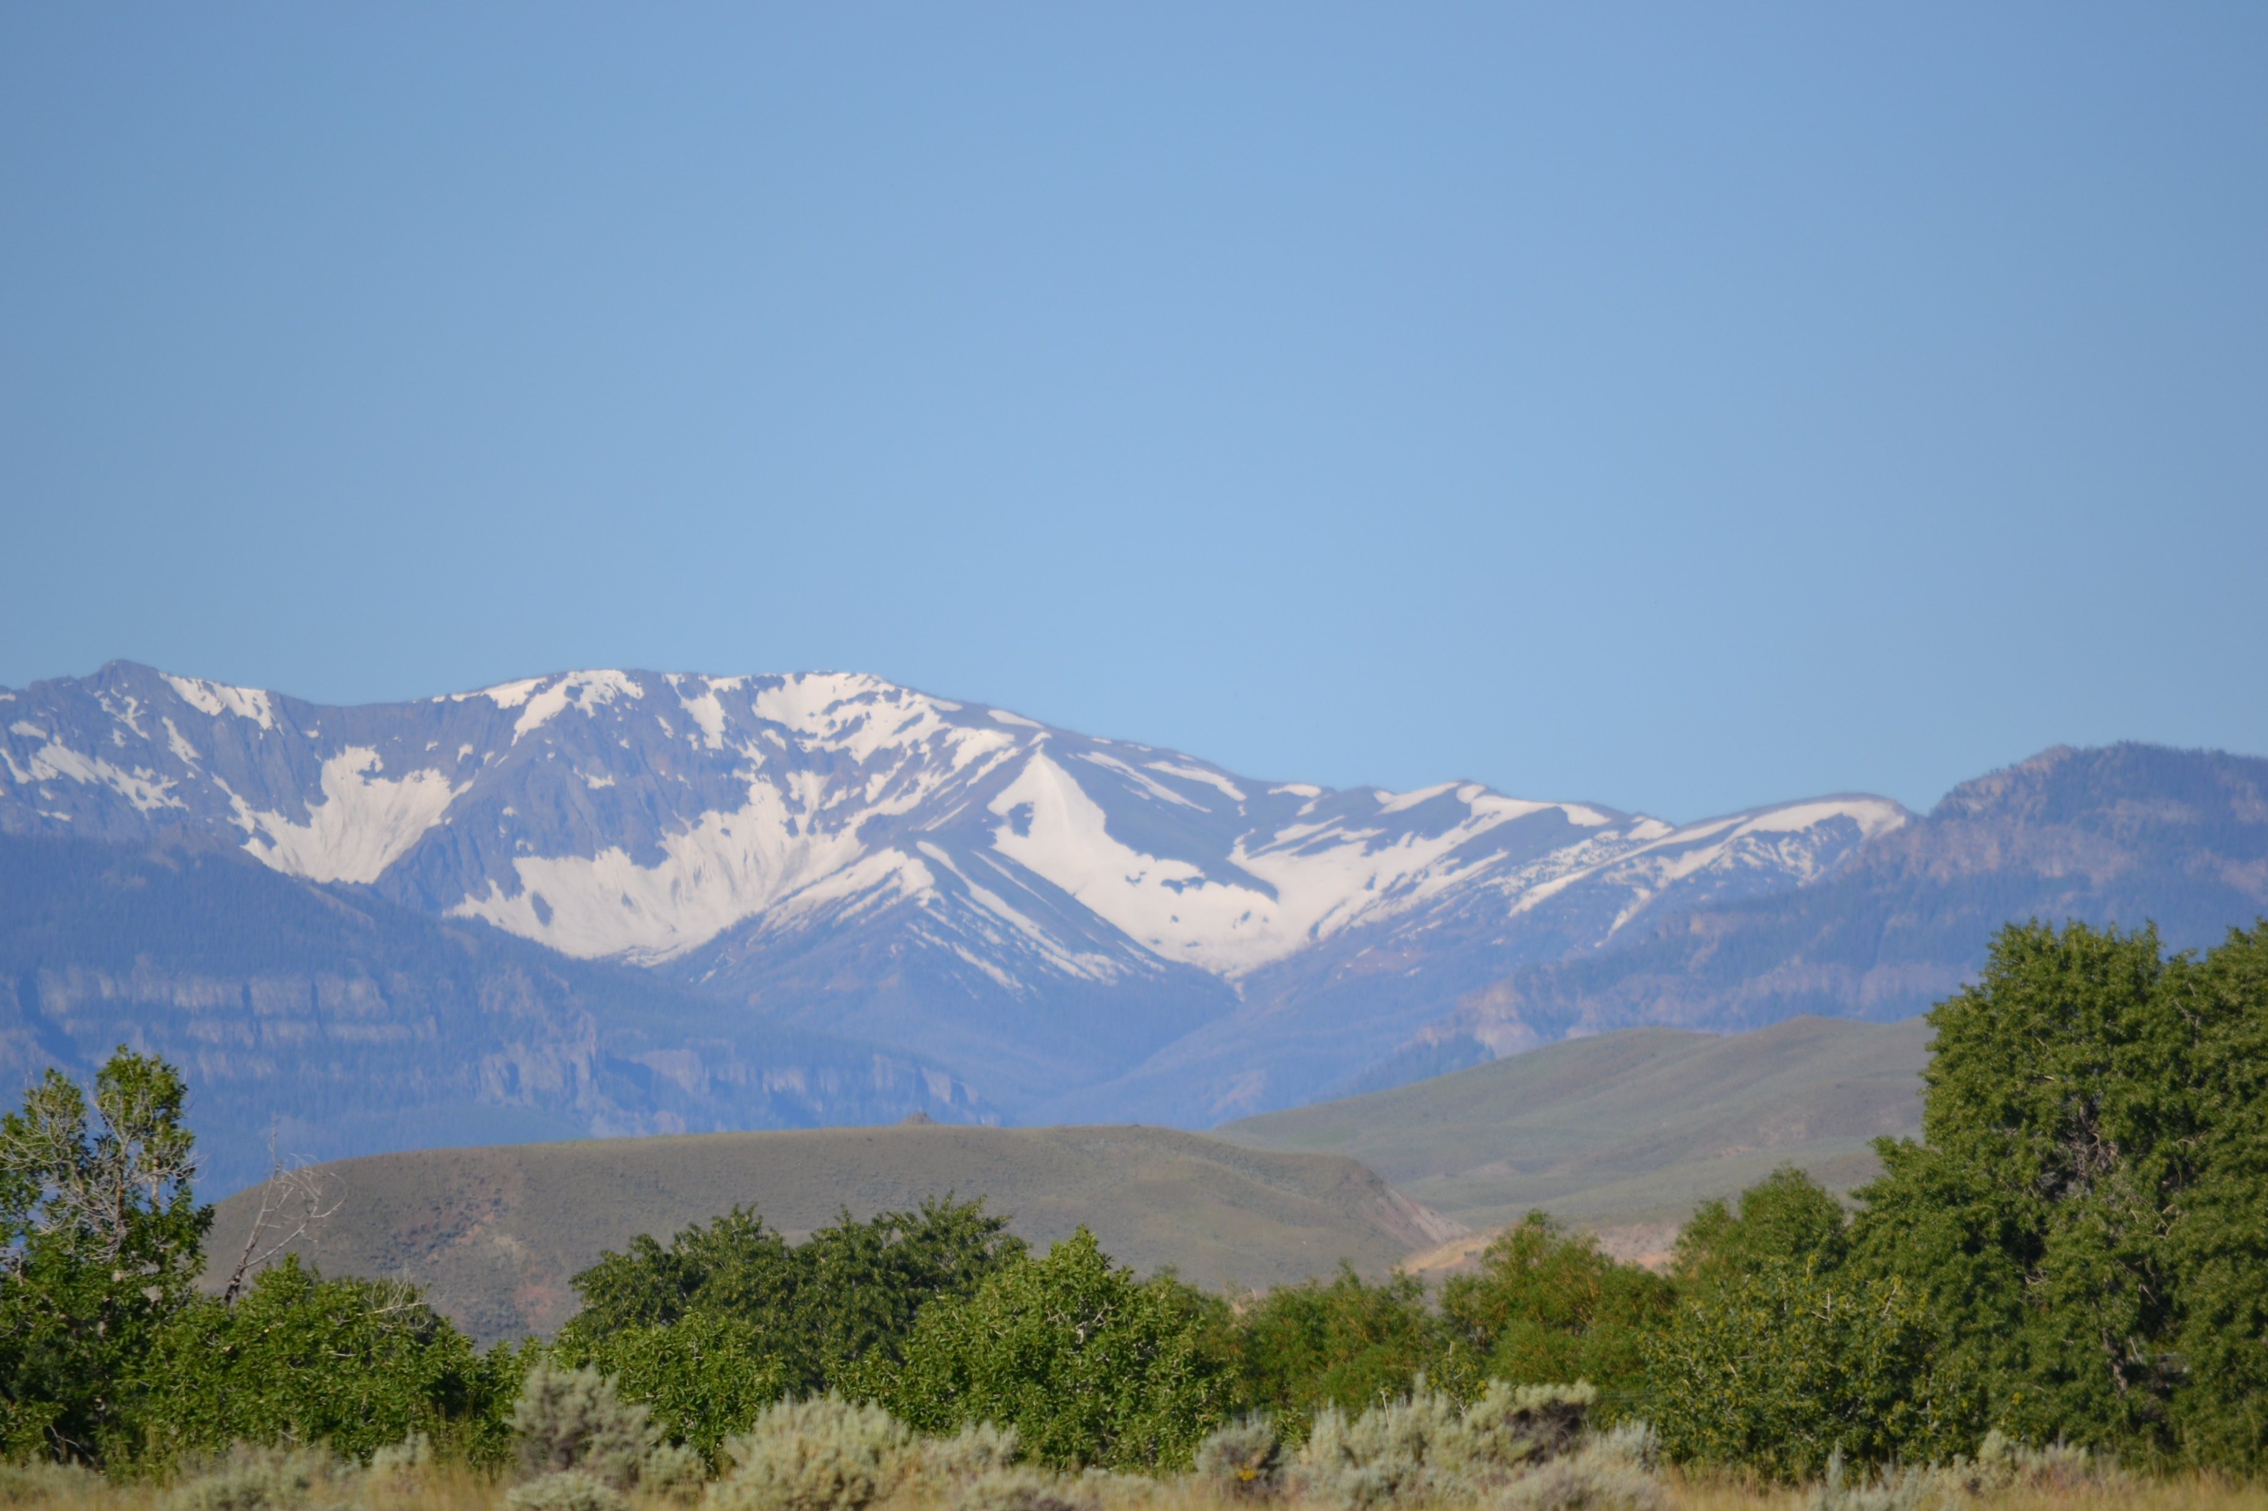
Cody Canal Irrigation District
2025
2265 Customers
15 Water Right Permits
13205 Acres of Water Rights
Canal Capacity is 250 CFS
70 miles of Main Canal and Cody Canal Laterals

Slide 14
Cody Canal Irrigation District
2025
Governed by 3 Commissioners, 1 from each districts:
  Matt Bell - Southfork District
  Dawn Jensen - Upper Sage District
  Dennis Reed - Lower Sage District
Manager:
  Jerry Bales
Secretary/ Legal council:
  Mary Helen Reed
Ditch riders:
  Kari Bales - Southfork
  Mike Zemke - Town
  Ty Wilcox - Sage creek

Slide 15
Cody Canal Irrigation District
Operation
Water is drawn directly from the Southfork of the Shoshone river.
Water flows though the canal system, for delivery to the original headgates of the fields.
When the fields have been subdivided, Cody canal will deliver the water the original headgate.
Water users' group will then deliver the water within the subdivision. They will need to maintain the delivery system, and rotate water between users as needed.
Some of the biggest challenges, are easement encroachment, and private ditch maintance. The entire system is built on easements.

Slide 16
Cody Canal Irrigation district
2025
The operation of Cody Canal has changed over the years. Now many of those farms have now been subdivided up . As subdividing occurred it has created more challenges.
  The farm is no longer the main source of income.
  A water system needs to by designed though out the subdivision to supply all the lots with water and carry runoff water back to a drain.
  The amount of water needed to flood irrigate is hard to regulate on the small fields. The time it takes to flow across a small field shorter, while the irrigator is working the job in town. Which then has the runoff water going across the neighbor’s property. If runoff ditches are not maintained properly, neighbors may be getting flood. Sprinklers are a good solution for this problem.
  Remember water runs down hill and doesn’t fallow fences.

Slide 17
Cody Canal Irrigation district
2025
Piping supply systems, and Sprinklers systems are the solution to the nightmare of flood irrigation in the smaller subdivision lots.
The water is applied where you want it with no runoff.
Sprinklers do have some challenges also.
  Cost to setup
  Regular maintance
  Cost of pumping.

Slide 18
Cody Canal Irrigation district
2025
Some of the biggest challenges,
  The entire system is built on easements.
  Easement encroachment
  Private ditch maintance in subdivisions
  Rotation scheduling

Slide 19
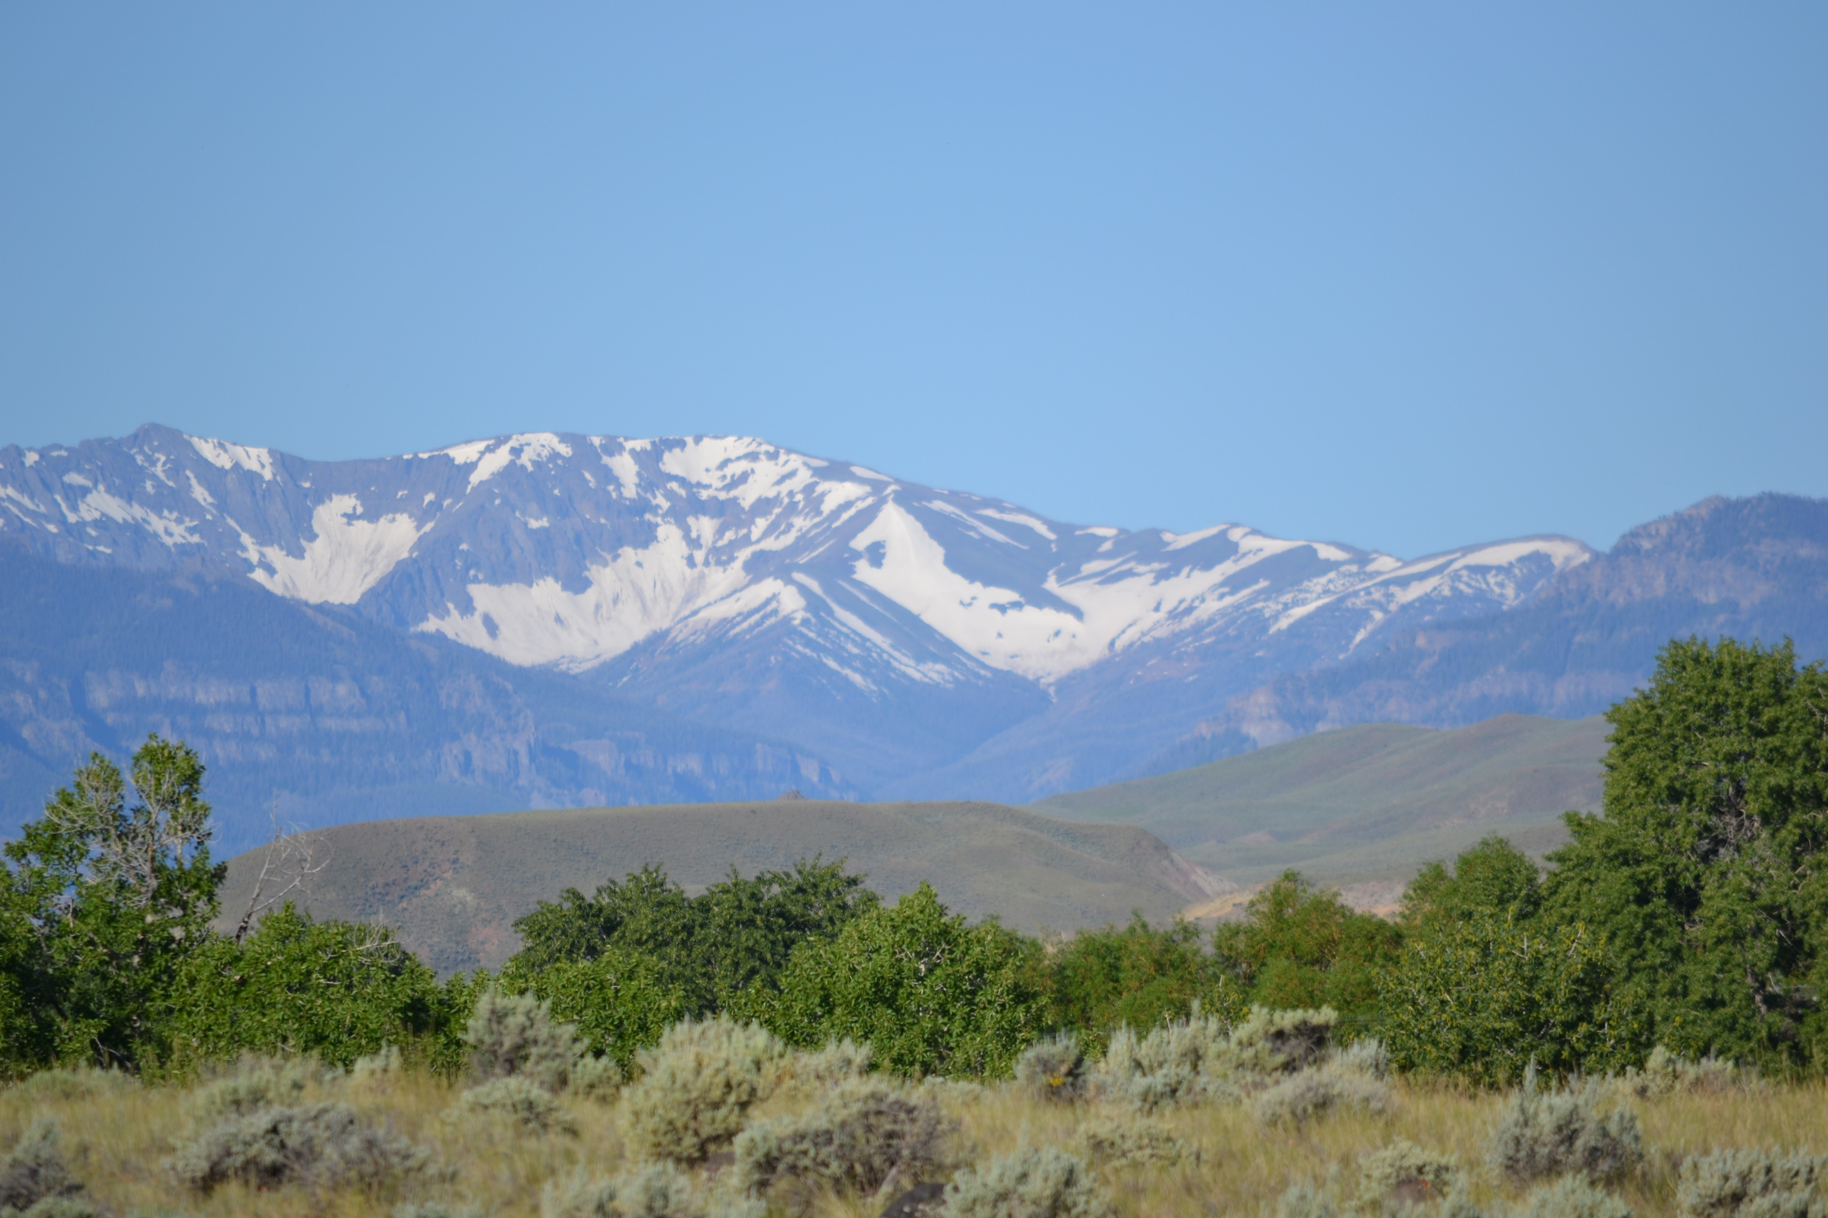
Horse’s Head
High water is over

Slide 20
Irrigation Types
Flood Irrigation
  Tarps
  Gated Pipe
  Siphon Tubs
Sprinkle Irrigation
  Lawn type
  Handline
  Side Roll
  Center Pivot
Drip Irrigation

Slide 21
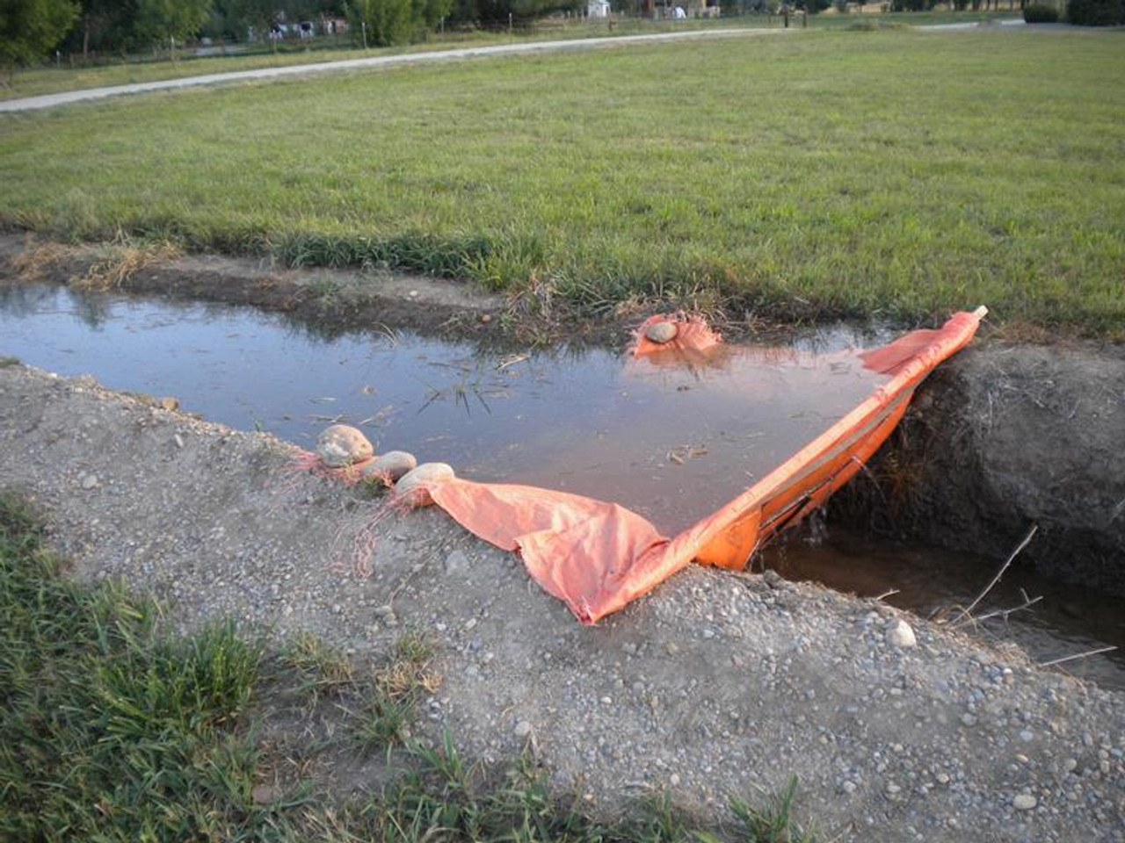
Tarps

Slide 22
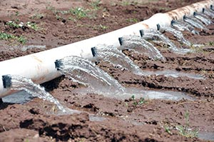
Gated Pipe

Slide 23
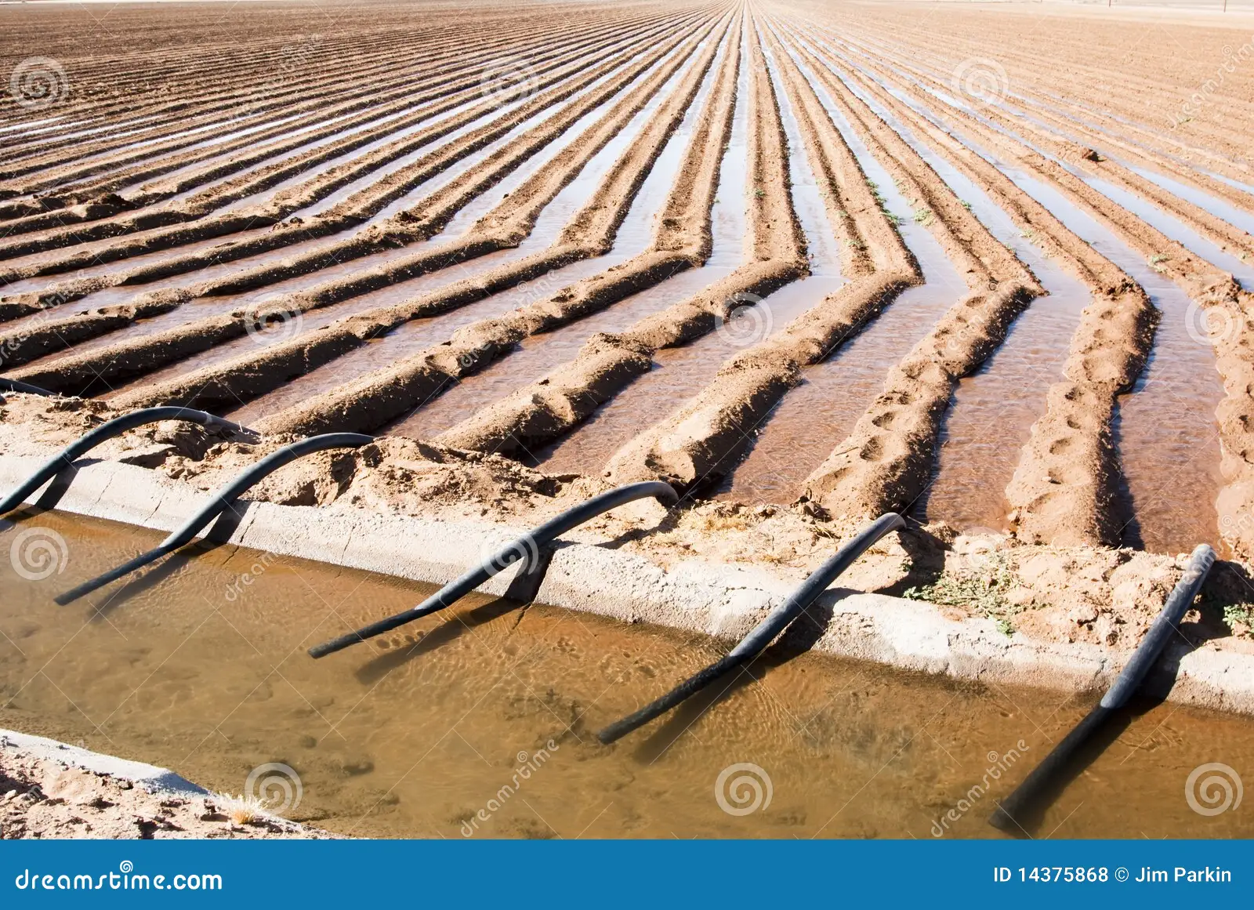
Siphon Tubs

Slide 24
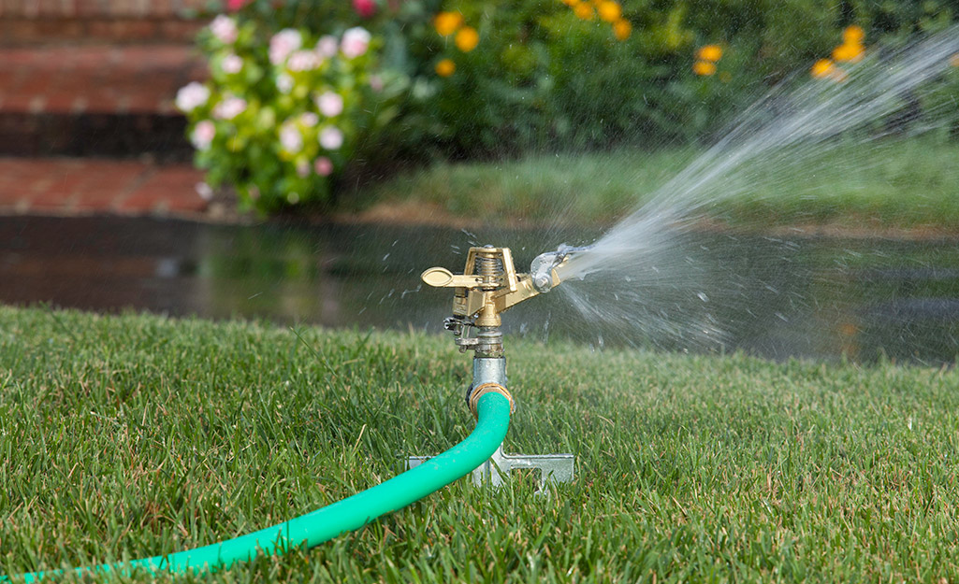
Lawn Sprinkler

Slide 25
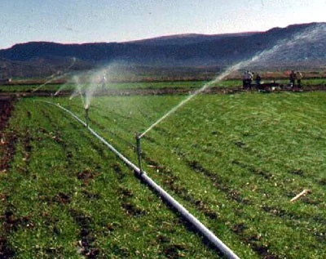
Handline Sprinklers

Slide 26
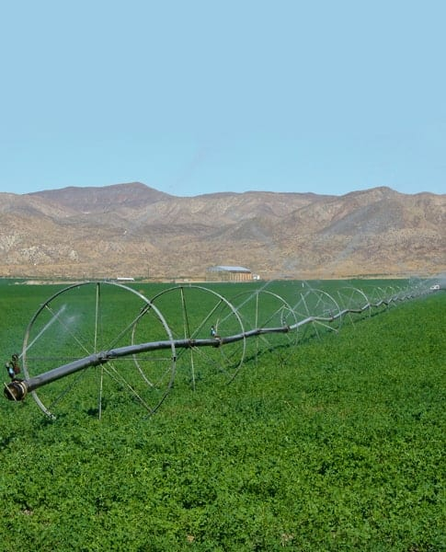
Side Roll Sprinkler

Slide 27
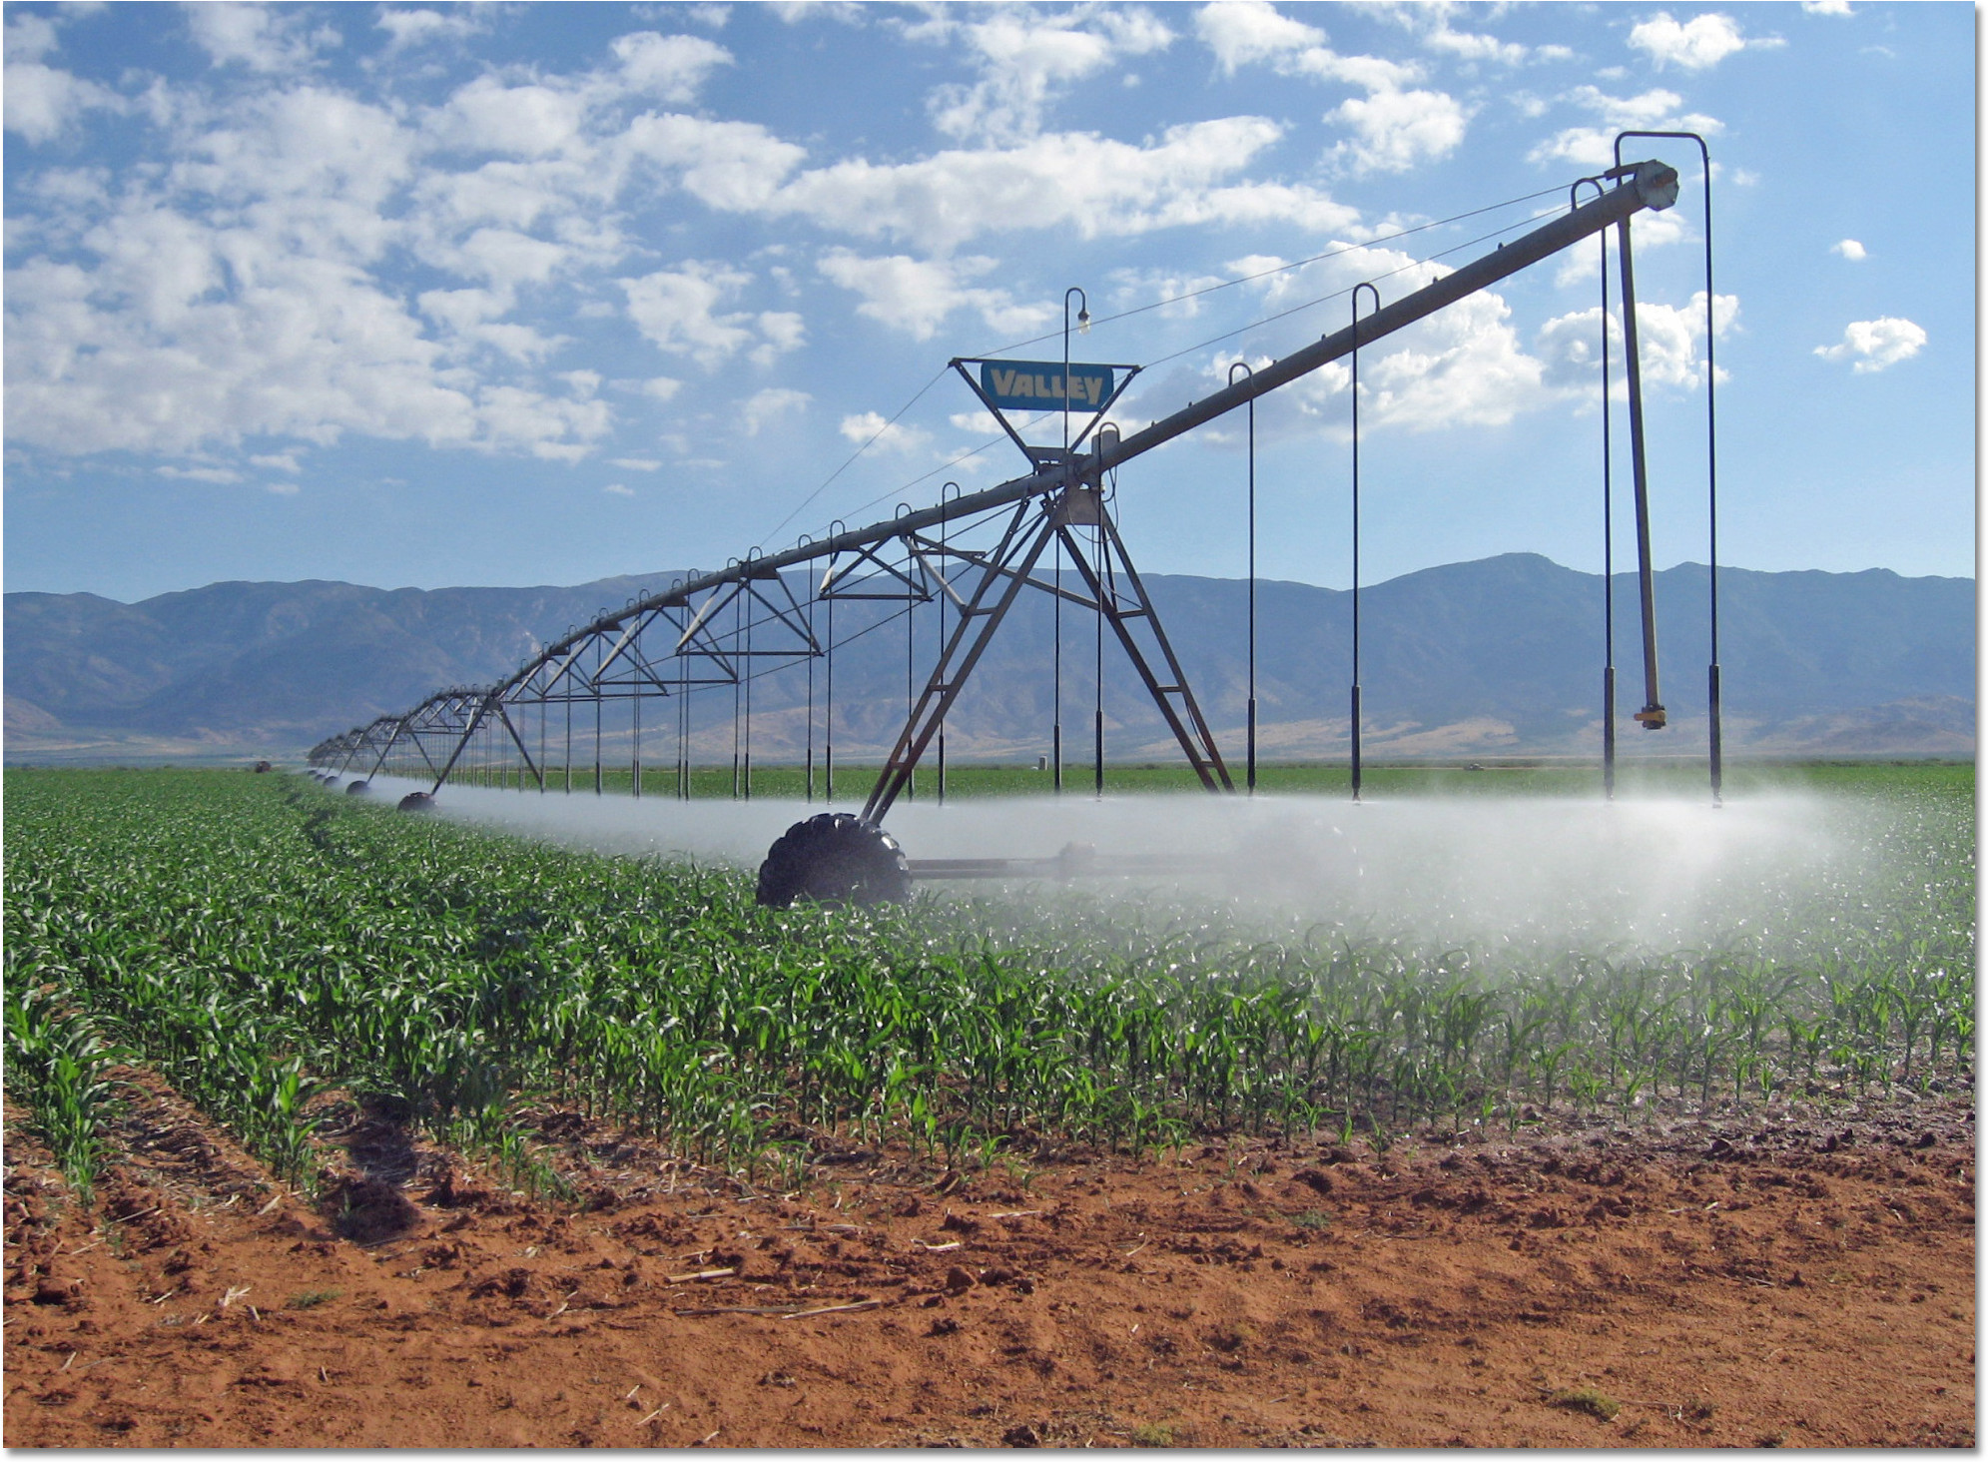
Center Pivot

Slide 28
Useful resources
Barnyards & Backyard
  Wyoming Small Acreage IRRIGATION
Wyoming State Engineer office (seo.wyo.gov)
  Legal Aspects Relating to Irrigation Ditch Rights and Easements
Local Irrigation Supply Businesses

Slide 29
Area Canal Contacts
Cody Canal - Jerry Bales 307-899-6644
Lake View - Cj Ney 307-899-4509
Wilson McKissack - Tom Bales 307-899-5396
Neff, Castle Rock - Kelly Bustos 307-250-3949
Wapiti Valley - Lee Livingston 307-307-899-3057
Shoshone - Trent Reed 307-754-5741
Heart Mountain - Tyler Weckler 307-754-4685
Willwood – Travis Moger 307-754-3831

